Slide 1
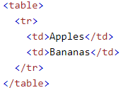
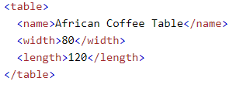
XML Namespaces
This XML carries HTML table information
This XML carries information about a table (a piece of furniture)
If these XML fragments were added together, there would be a name conflict. Both contain a <table> element, but the elements have different content and meaning.
A user or an XML application will not know how to handle these differences.
Name conflicts in XML can easily be avoided using a name prefix.

Slide 2
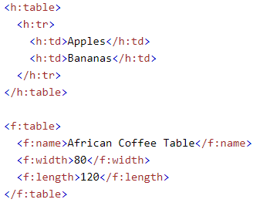
XML Namespaces
This XML carries information about an HTML table, and a piece of furniture
In the example above, there will be no conflict because the two <table> elements have different names.

Slide 3
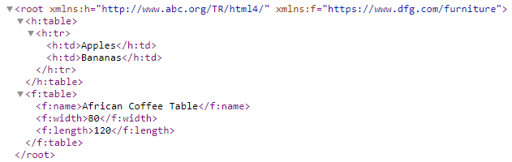
XML Namespaces
When using prefixes in XML, a namespace for the prefix must be defined.
The namespace can be defined by an xmlns attribute in the start tag of an element.
The namespace declaration has the following syntax. xmlns:prefix="URI".
The xmlns attribute in the first <table> element gives the h: prefix a qualified namespace.
The xmlns attribute in the second <table> element gives the f: prefix a qualified namespace.
When a namespace is defined for an element, all child elements with the same prefix are associated with the same namespace.

